Slide 1

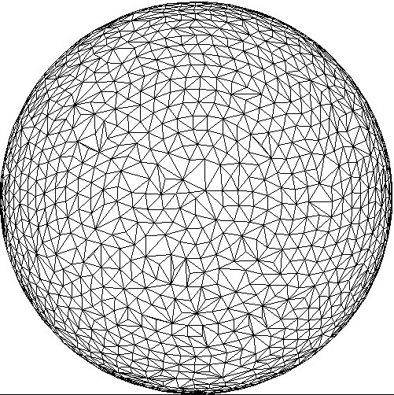
Computational Geometry Convex Hull in 3-Space
Jonas Sorgenfrei

Slide 2
Contents
Introduction
Convex Hull Overview
Properties
Algorithms 2D
Graham Scan-Algorithm
Sample Program
Convex Hull in 3D
Complexity
Computation
Sample Program
Computer Graphic Applications
Collision Detection
Simulations

Slide 3
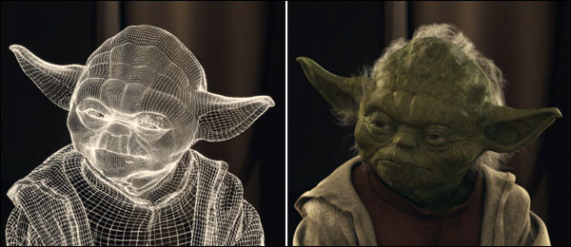
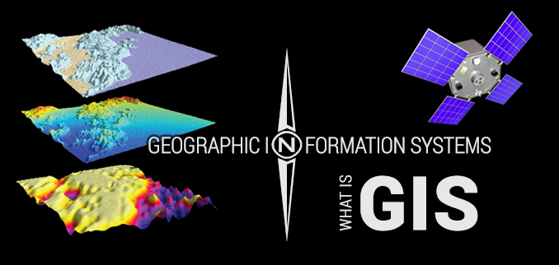
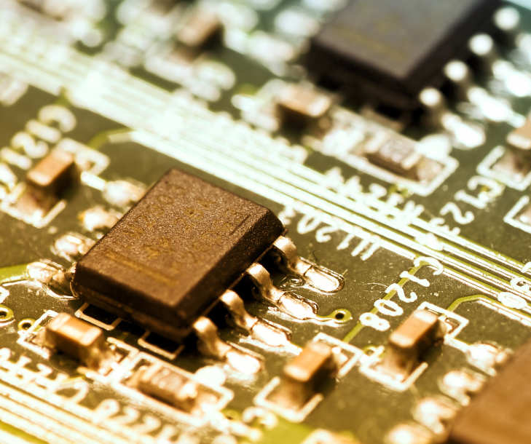

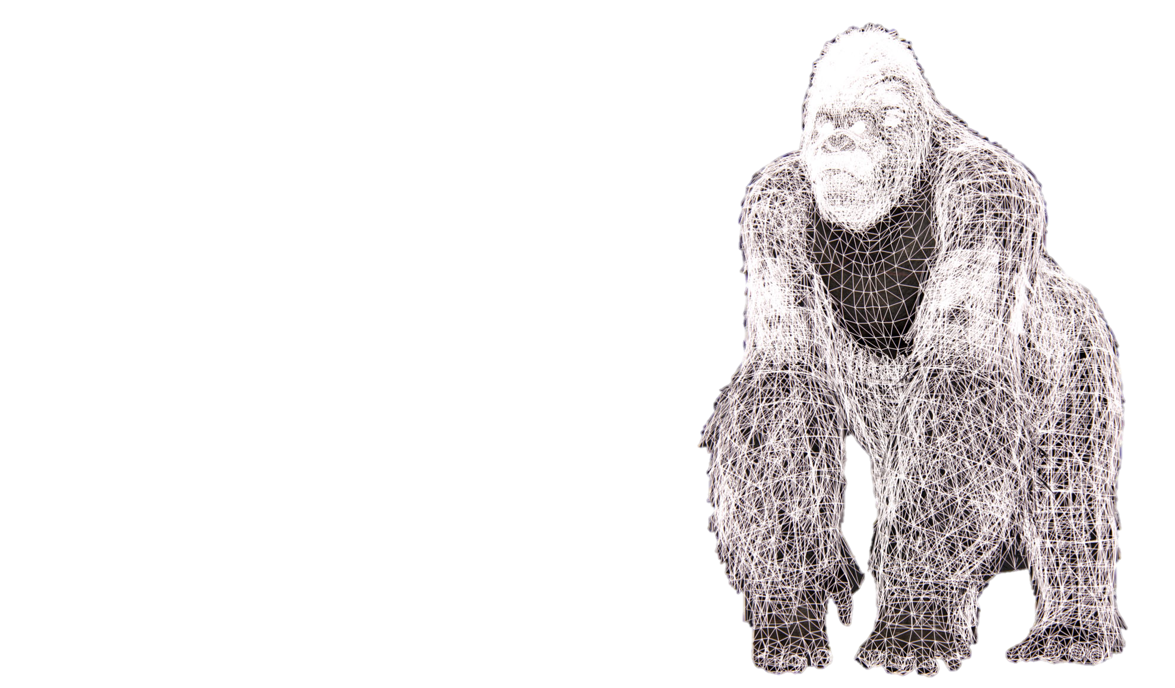
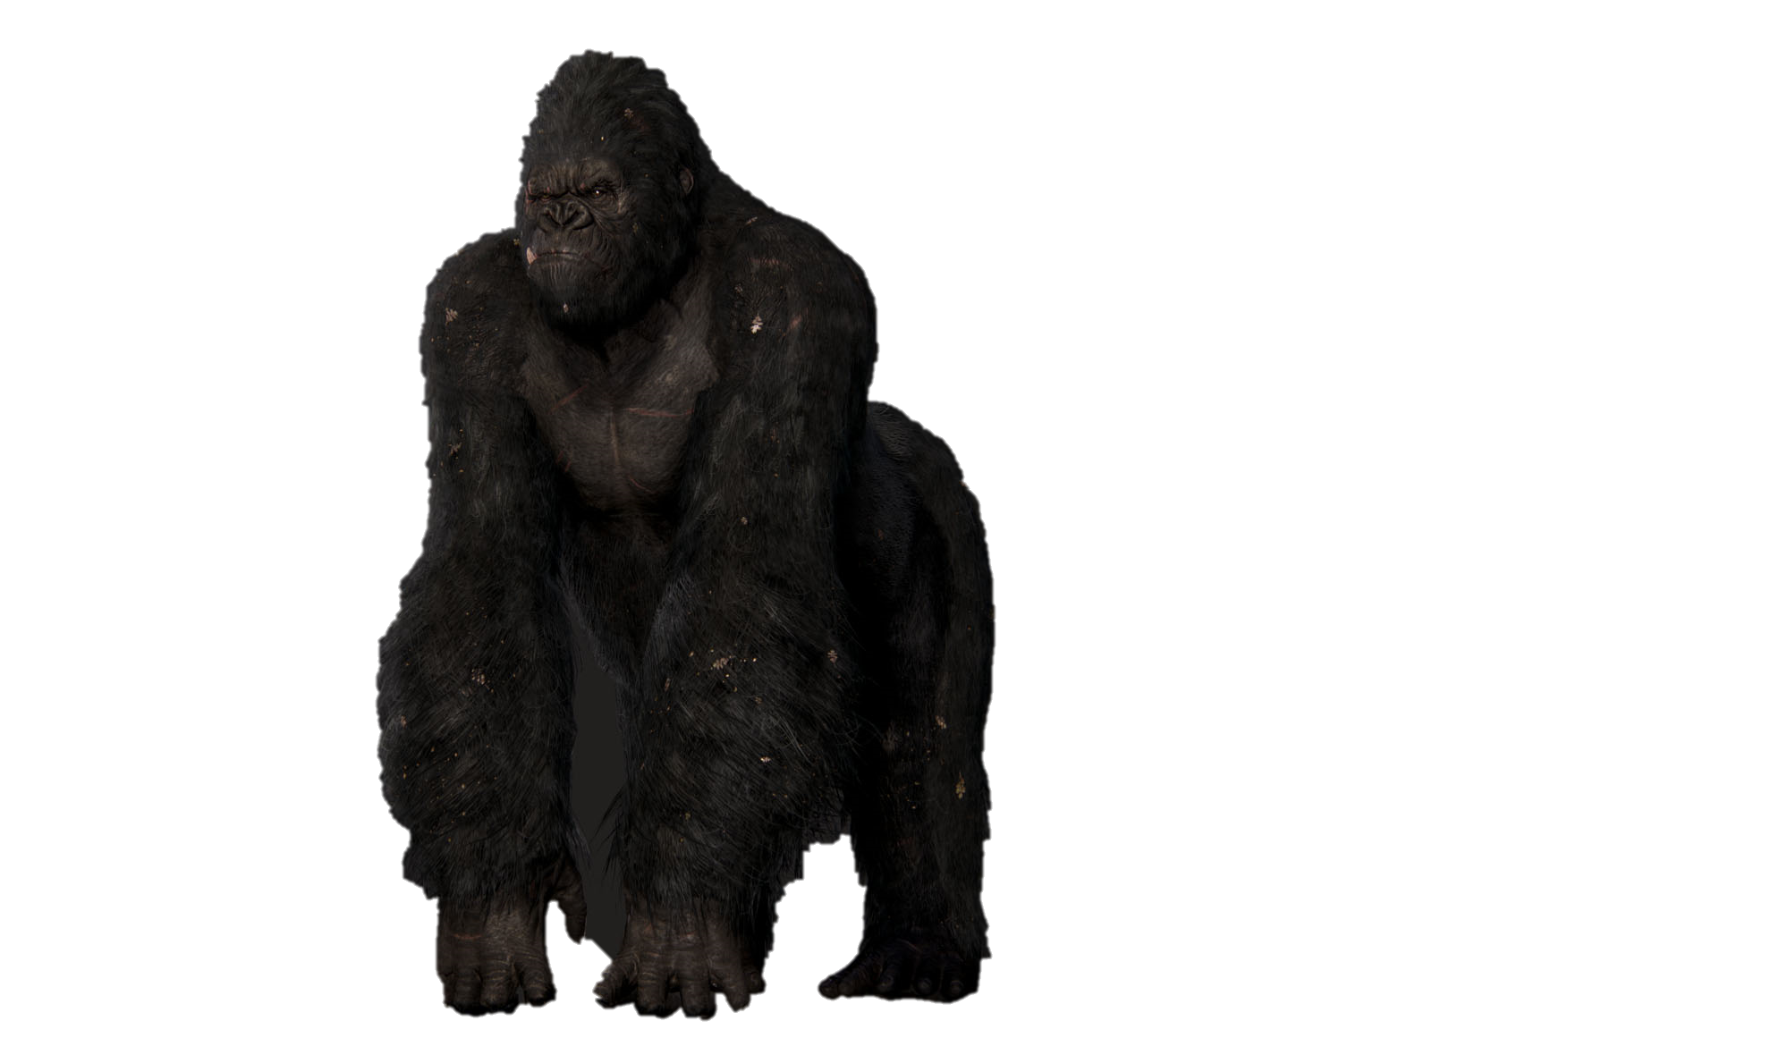


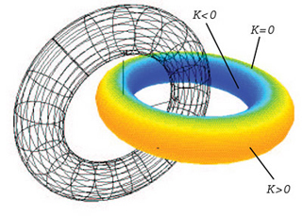
Introduction
[6] – Computer Vision
[2] – Geographic Information Systems
[3] – Integrated Circuit design
[5] - Databases
[4] – Computer-Aided Engineering
[1] - Robotics
[7] – Computer Vision
Notes:
branch of computer Science
systematic study of algorithms & data structures for geometric objects
Applications
robotics (motion planning & visibility problems)
geographic information systems (GIS) (location and search, route planning)
Integrated circuit design (IC geometry design and verification)
Computer-aided engineering (CAE) (mesh generation) [mechanical engineering]
Computer Aided Design (CAD) & Computer Aided Manufacturing (CAM)
Databases (efficient ways of saving and retrieving data)
Computer Vision (3D reconstruction) [movies & computer games]
(other applications: molecular modeling, pattern recognition, )
Simple Example: Closest pair problem
Given n points in the plane, find the 2 with the smallest distance from each other
Brute-force algorithm: O(n²)
Optimization to O(n log n) or better

Slide 4
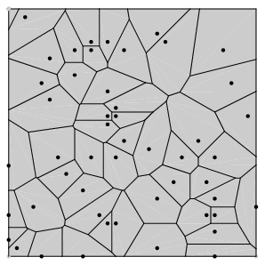
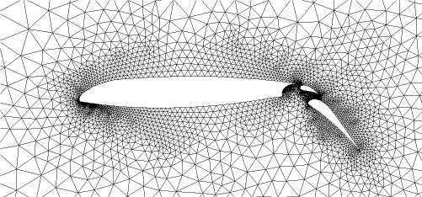
Introduction
What computational geometry is.
[4]
[7]
[2]
[3]
[1]
[5]
Why computational geometry matters.
[6]
Notes:
branch of computer Science
systematic study of algorithms & data structures for geometric objects
Applications
robotics (motion planning & visibility problems)
geographic information systems (GIS) (location and search, route planning)
Integrated circuit design (IC geometry design and verification)
Computer-aided engineering (CAE) (mesh generation) [mechanical engineering]
Computer Aided Design (CAD) & Computer Aided Manufacturing (CAM)
Databases (efficient ways of saving and retrieving data)
Computer Vision (3D reconstruction) [movies & computer games]
(other applications: molecular modeling, pattern recognition, )
Simple Example: Closest pair problem
Given n points in the plane, find the 2 with the smallest distance from each other
Brute-force algorithm: O(n²)
Optimization to O(n log n) or better

Slide 5
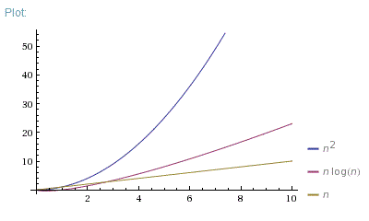
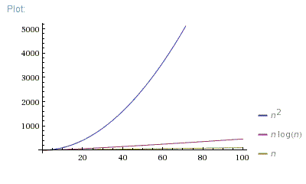
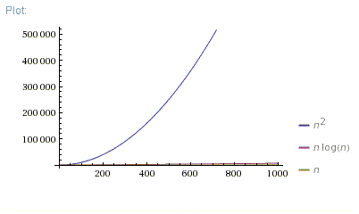
Introduction
Why efficients matters.
Plots of linear, squared and logarithmic running time
Notes:
should be efficient; O(n²) and O(n log n) can make a difference from seconds to days of calculation

Slide 6
Introduction
edge
vertex
facet
Notes:
→ working on geometric structural elements (Points, Lines, circles, polygons and polyhedra)
facet = (d-1)-face
0-face = vertex
1-face = edge
Face = Intersection of a polytop P with a supporting hyperplane
(max. subset of coplanar points on it‘s boundary)

Slide 7
Convex Hull
Problem:
Given a set of n points, find the minimal convex polygon that contains all the points.
Notes:
Definition:
smallest convex set containing the points
more precisely: the intersection of all convex sets containing the points
→ one of the first problems studied in computational geometry (2D)

Slide 8
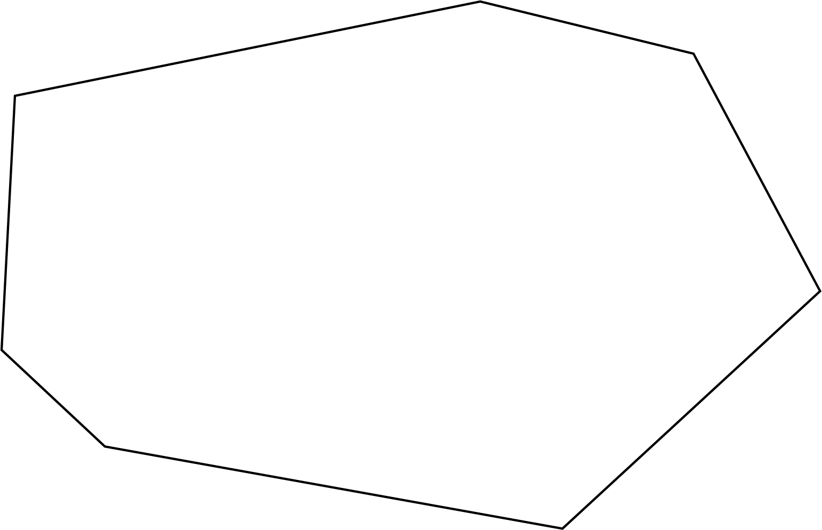
Convex Hull - Properties
Notes:
Blackboard → Physic lenses convex and concave
Properties
1) Convex → a subset S is convex, if for any pair p,q e S the line pq is completely contained in S
Line connecting 2 points on the CH doesnt intersect with any other border line
2) Only left turns (CCW)
3) For every edge all points lie on the left of the edge (CCW)
CH(S) is the smallest convex set, that contain S
→ Represented as points sorted in CW/CCW order
has at most n points (in a set of n points)

Slide 9
Convex Hull - Algorithms
Graham Scan Algorithm
Notes:
1) Line connecting 2 points on the CH doesnt intersect with any other border line
2) Only left turns (CCW)
3) For every edge all points lie on the left of the edge (CCW)
-> has at most n points (in a set of n points)

Slide 10
Convex Hull - Algorithms
Convex-Hull Stack
8
7
5
3
1
0
Convex-Hull Stack
8
7
5
3
1
0
Convex-Hull Stack
11
5
3
1
0
Convex-Hull Stack
3
1
0
Convex-Hull Stack
4
3
1
0
Convex-Hull Stack
5
3
1
0
Convex-Hull Stack
6
5
3
1
0
Convex-Hull Stack
2
1
0
Convex-Hull Stack
12
5
3
1
0
Convex-Hull Stack
13
5
3
1
0
Convex-Hull Stack
9
8
7
5
3
1
0
Convex-Hull Stack
10
7
5
3
1
0
Convex-Hull Stack
7
5
3
1
0
Convex-Hull Stack
7
5
3
1
0
Convex-Hull Stack
14
5
3
1
0
Convex-Hull Stack
15
14
5
3
1
0
5
3
11
7
4
10
8
6
2
1
14
13
15
12
9
0

Slide 11
Convex Hull - Algorithms
Pseudo Code – Graham Scan Algorithm
Select the point with the minimum y and Swap with point at [0]
Sort all points in CCW order {p₀, p₁, …, p_{n}}
S = {p₀,p₁,p₂}
for i = 3 to n
While |S| > 2 && p_{i} is to the right of S₋₂,S₋₁
S.pop
S.push(p_{i})
Notes:
O(n log n) in time | O(n) in space
Optimal in worst case | not optimal in average case
Serial
Not dynamic
Info / other algorithms existing with different running times, better or worse depending on the input set of points

Slide 12
Convex Hull – Algorithms DEMO
Notes:
Run Demo of program

Slide 13
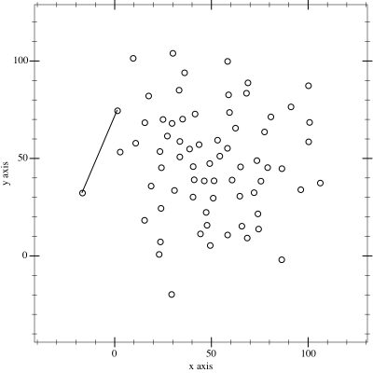
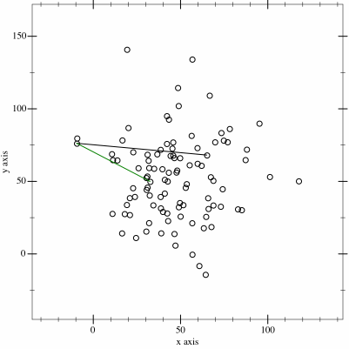
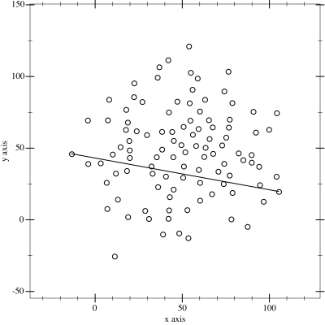
Convex Hull Algorithms
Naive Convex Hull Algorithm
Graham Scan Algorithm
Monotone Chain Algorithm
Gift Wrapping Algorithm
Divide & Conquer Convex Hull Algorithm
Incremental Convex Hull Algorithm
Quick Hull Algorithm
Notes:
Naive Algorithm → iterate over all pos. Line segments, part of CH, if all points are to it’s left, CCW-Order | O(n³)
Graham Scan Algorithm → Example | O(n log n)
Monotone Chain Algorithm → sorting points by one coordinate (e.g. x-coordinate)
Gift Wrapping Algorithm (aka Jarvis March) → Calc one by one | O(hn) – h → number of CH facets
Divide & Conquer Algorithm → Split S into two Subsets, calc CH and Merge CH’s | O(n log n)
Incremental CH Algorithm → Start with initial CH, add points one by one (if inside or on border ignore, only add if outside)
Quick Hull Algorithm → (similar to Quick Sort) find pivot, split points along the pivot, recursively process each side | O(n log n) expected time ; O(n²) worst case
Chan -

Slide 14
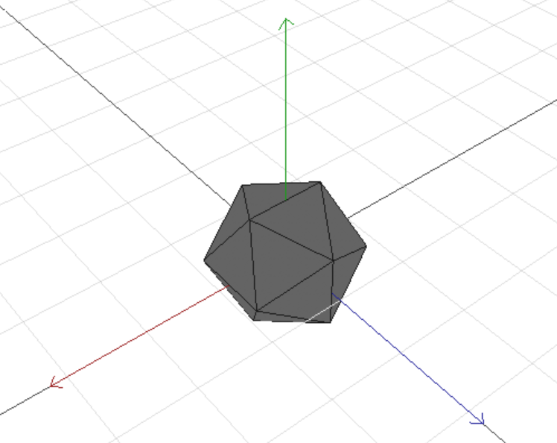
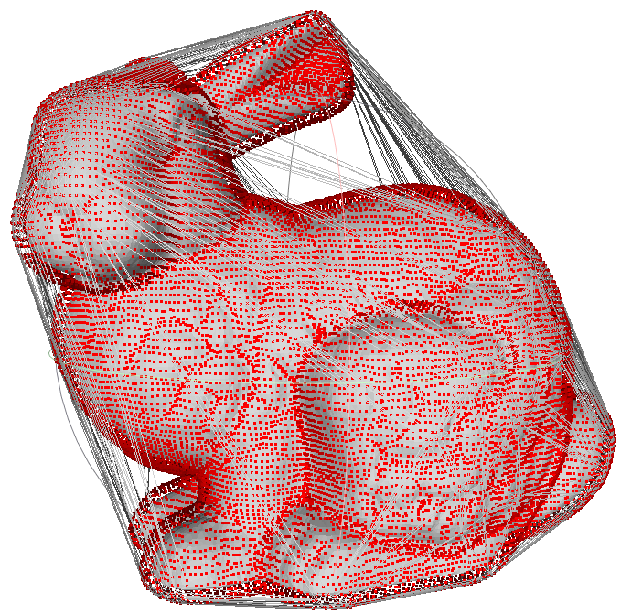
Convex Hull 3D
polyhedron (convex 3-polytop) containing points
for every facet of CH(P)
all other points of P lie in only one half space(back side)
Frontface – CCW-Order
Notes:
Polyhedron (Greek: “many bases”) : 3D-Space 3-Polytop
P set of points
CH(P) subset
Backside, in this case defined by order, clockwise (backface), counter-clockwise (frontface)
Backface normal pointing to the inside of the polyhedron
Frontside normal pointing to the outside of the polyhedron

Slide 15
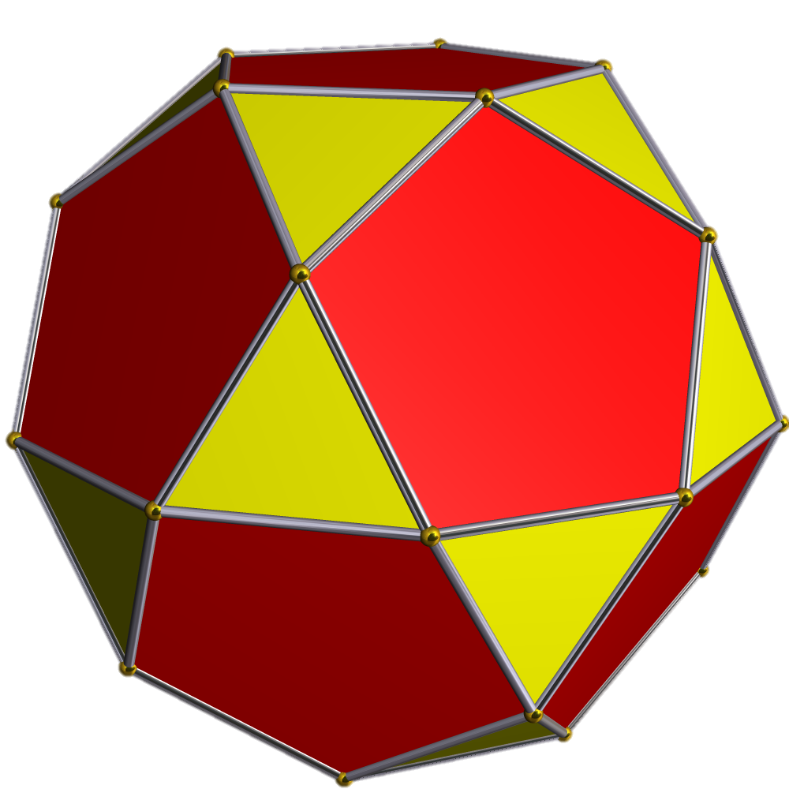
Convex Hull 3D - Complexity
number of edges can be higher than the number of vertices
facet = convex polygon
Icosidodecahedron
Notes:
the CH of a set P of n points is a convex polytope whose vertices are points in P and, hence, it has at most n vertices
Worst case complexity = if all point are on CH
Simplicial polytope - simplicial polyhedron (only Triangles faces (simplexes))
___
Intersection of finite number of closed half spaces h+
Simplex = CH of k + 1 affine independent points (Point, Line, Triangle, Tetrahedron)

Slide 16
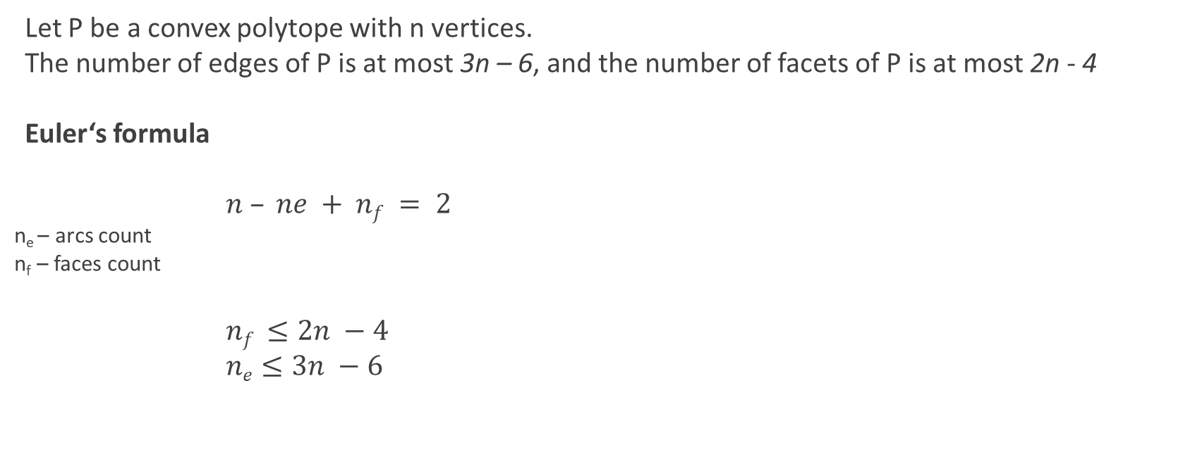
Convex Hull 3D - Complexity
Let P be a convex polytope with n vertices.
The number of edges of P is at most 3n – 6, and the number of facets of P is at most 2n - 4
Euler‘s formula
$n – ne + nf = 2$
n_{e} – arcs count
n_{f} – faces count
$nf ≤2n −4$
$ne≤3n −6$
Cube interpreted as a planar graph.
Notes:
Number of edges of a planar polygon is equal to the number of vertices
Cube -> planar graph (one facet maps to the unbounded face of the graph)
-> every face at least 3 arcs
-> every arc atleast 2 faces
2ne >= 3nf (3 edges shared by 2 triangles)
Euler formula
V – E + F = 2 V = n point
V – E + 2 E / 3 = 2 F = 2 E / 3
E = 3 V – 6 , V = n F = O(n)
E = O(n)
In Eular Formular: n + nf – 2 >= 3nf/2
Theorem holds as well for non-convex polytops (genus = 0; without holes or tunnels)

Slide 17
Convex Hull 3D - Complexity
The complexity of the convex hull of a set of n points in three dimensional space is
O(n)
Notes:
Combining Theorem &
Fact: CH of a set of points in 3d-space is a Convex polytop whose vertices are points in P.

Slide 18
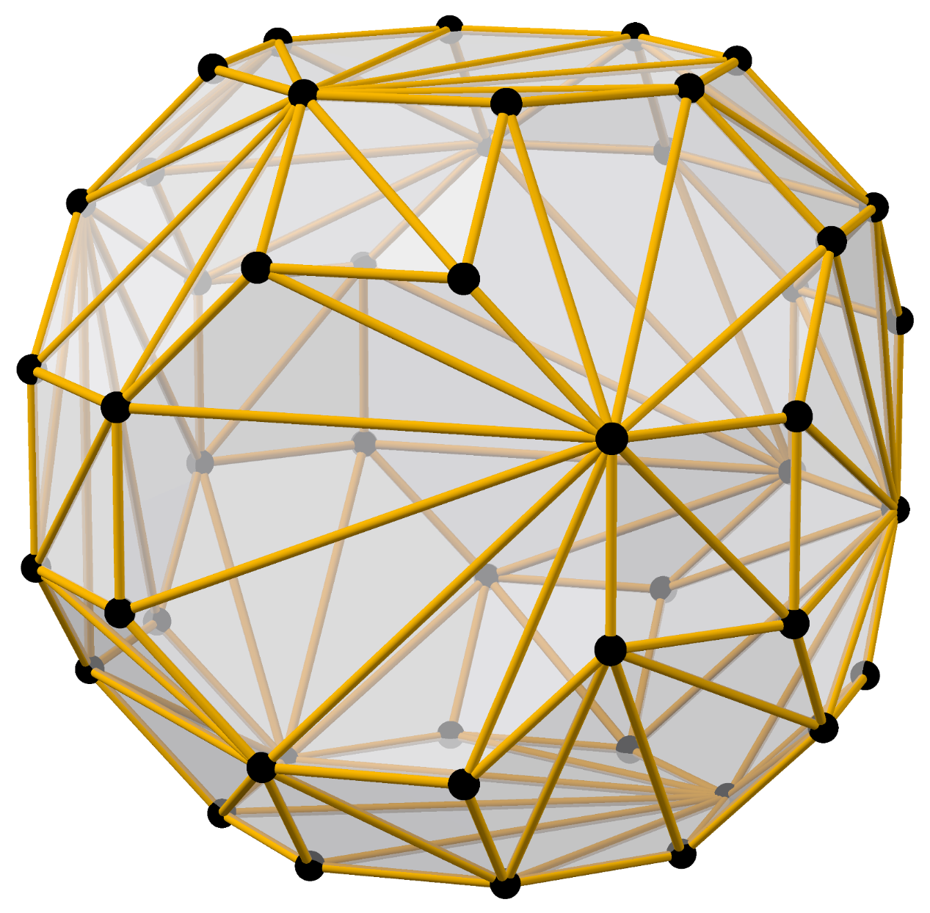
Convex Hull 3D - Computation
2 main problems
finding extreme points
finding connectivity
Saving CH in a Data Structure
Saving Points
Saving Facets (Connection of points)
Notes:
Def: extreme point → part of CH
interior point → not part of CH

Slide 19
Doubly Connected Edge List
data structure
represents an embedding of a planar graph in the plane and polytopes in 3D
needs functions to work on abstract data structure
links together:
Vertex
Halfedge
Edge Connecting P1 → P2
(Twin) Edge Connecting P2 → P1
Face
complex & complicated structure/programming!
Notes:
Store as doubly connected edge list
=> storing planar subdivisions

Slide 20
Alternative Structur: Incident graph
Stores topology of the polytop
Dimension

Slide 21
Convex Hull 3D - Computation
Randomized incremental algorithm
Input
P = Set(point₁, point₂, … point_{n})
Output
CH(P) (Convex Hull of P)
Notes:
Randomized Incremental Algorithm
Input
Set of Points or Vector of Points (in the example code)
Output

Slide 22
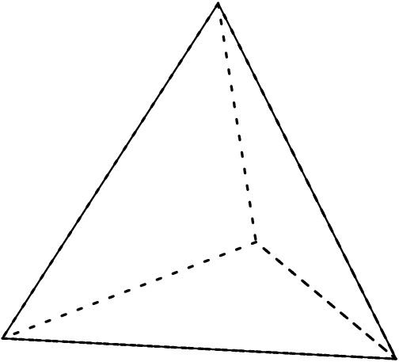
Convex Hull 3D - Computation
1) choosing 4 Points, that don’t lie in a common plane (tetrahedron)
p1 and p2 be 2 Points in P
p3 a point in P that does not lie on the line of p1 and p2
p4 a point in P that does not lie in the plane p1,p2,p3
(can’t find 4 points → all point in P in a plane → 2D CH algorithm)
2) compute random permutation p₅, … p_{n} of remaining points
3) for all points p₅,…,p_{n}
In a generic step of the algorithm we have to add the point p_{r} to the convex hull of CH(P_{r-1})
→ transform CH(P_{r-1}) to CH(P_{r})
➔if p_{r} in CH(P_{r-1}) or on it’s boundary => CH(P_{r}) = CH(P_{r-1})
➔else p_{r} outside of CH(P_{r-1}) adding new point deleting old ones
Tetrahedron
Notes:
Usign determinante to check sub 2 for colinear points
2) We will consinder the points one by one in this random order, maintaining the CH as we go
Facets created by the insertion of pr are all triangles, except for those that have been merged with existing coplanar facets

Slide 23
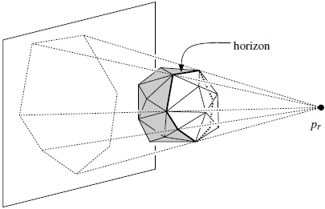
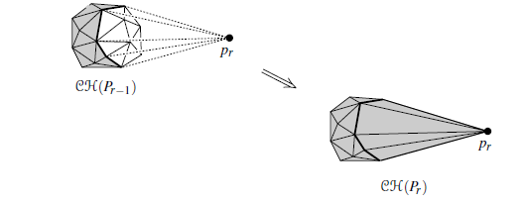
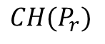
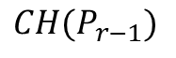
Convex Hull 3D - Computation
$$CH(P_{r−1})$$
$$CH(P_{r})$$
Notes:
pr outside of CH(Pr -1)
-> visible region (white) of pr on CH(Pr-1)
-> horizon (black) enclosed by a curve consisting of edges of CH(Pr-1)
crucial role when we want to transfrom CH(Pr-1) to CH(Pr)
Projection of the horizon is the boundary of the convex polygon obtained by projection CH(Pr-1) onto a plane
(pr => center of projection)
Invisible facets can be kept
Visible face -> replaced by facets connectin pr to ist horizon
Transform CH(Pr-1) to CH(Pr)

Slide 24
Convex Hull 3D - Computation
f is visible from p,
but not from q
p
f
q
h_{f}
Notes:
Visibile – plane hf containg facet f of CH(Pr-1)
by convexity CH(Pr-1) is completely contained in on of the closed half-space on the other
side of hf
f is visibile from a point if that point lies in the open half-space on the otehr side of hf
We have to check whether we have created a coplanar facet (if pr lies in the plane of a Facet of CH(Pr-1))
Have to be merged with f into one facet
Hyperplane => divides the space into (open) halfspaces h+ and h-
E^{n}= h+ u h u h-
___ __
Def: h+=h+u h ; h-=h- u h (closed halfspaces)

Slide 25
Conflict Graph
Data structure to store
visible facets {f_{n}, f_{m},.. } from point p_{t}
as conflicts
visible points {p_{n}, p_{m},.. } from point f_{t}
as conflicts
methods for finding Conflicts-Partners
P_{conflict}(f) – List of Points in Conflict with Face f
F_{conflict}(p_{t}) – List of Faces in Conflict with Point p_{t}
conflicts
points
facets
f
p_{t}
P_{conflict}(f)
F_{conflict}(p_{t})
Notes:
Finding Facets:
Testing Every Facet => Test = constant time ; visible facets O( r ) time [O(n²) algorithm]
IMPROVMENT:
-> working ahead
Maintain for each facet f of the curr. CH(Pr) a set
Pconflict(f) containing {pr+1, pr+2,….,pn} => containing the points that can see f
For every point pt (t > r) store set Fconflict(pt) of Facets of CH(Pr) visible from pt
Conflict: a point p e Pconflict(f) is in conflict with the facet f, because p and f cannot peacefully live together in the convex hull
once we add a point p e Pconflitct(f) to the CH, the facet f must go
Conflict-list: Pconflict(f) + Fconflict(pt)
Conflict Graph: bipartite graph
left side: set with a node for every point that hasnt been inserted yet
right side: set with a node for every facet of the current convex hull
arc: for every conflict between a point and a facet
=> using CG G we can report the set Fconflict(pt) for a given point pt (or Pconflict(f) for a given facet f) int time linear in its size
Initializing G for CH(P4) => linear time
Updating => 1. discard nodes and incident arcs for all the facets of CH(Pr-1) that disappear from the CH
2. discard node for pr
3. add nodes to G for the new facets we created
4. find the conflicts to these new facets (no other conflicts have to be updated)

Slide 26
Convex Hull 3D – Algorithmen
Algorithm CONVEXHULL(P)
Input. A set P of n points in three-space.
Output. The convex hull CH(P) of P.
1. Find four points p₁, p₂, p₃, p₄ in P that form a tetrahedron.
2. C ← CH({p₁, p₂, p₃, p₄})
3. Compute a random permutation p₅, p₆, … p_{n} of the remaining points.
4. Initialize the conflict graph G with all visible pairs (p_{t}, f), where f is a facet of C and t > 4
5. for r ← 5 to n
6. do(* Insert p_{r} into C: *)
7. if F_{conflict}(p_{r}) is not empty (* that is, p_{r} lies outside C *)
8. then Delete all facets in F_{conflict}(p_{r}) from C
9. Walk along the boundary of the visible region of
p_{r} (which consists exactly of the facets in F_{conflict}(p_{r})) and
create a list L of Horizon edges in order.
Notes:
Due to Clarkson and Shor

Slide 27
Convex Hull 3D – Algorithmen
10. for all e ∈ L
11. do Connect e to p_{r} by creating a triangular facet f.
12. if f is coplanar with its neighbor facet f‘ along e
13. then Merge f and f‘ into one facet, whose conflict list is the same as that of f‘.
14. else (* Determine conflicts for f: *)
15. Create a node f in G.
16. Let f₁ and f₂ be the facets
incident to e in the old
convex hull
17. P(e) ←P_{conflict}(f₁) U P_{conflict}(f₂)

Slide 28
Convex Hull 3D – Algorithmen
18. for all points p ∈ P(e)
19. do If f is visible from p, add (p,f) to G.
20. Delete the node corresponding to p_{r} and the nodes corresponding to the facets in F_{conflict}(p_{r}) from G, together with their incident arcs.
21. return C
Mark de Berg / Otfried Cheong / Marc van Kreveld / Mark Overmars: Computational Geometry, Algorithms and Applications Springer 2008 (3. Aufl.), ISBN 978-3-540-77973-5
Notes:
N -> Space

Slide 29
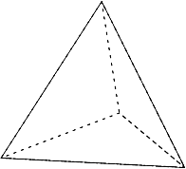
Convex Hull 3D – Algorithmen Overview
Starting with a Tetrahedron
4 non-Coplanar points of the Set P
Compute random permutation for remaining points
Initialize the Conflict-Graph with Tetrahedron & remaining points
Loop over all remaining points
Check if Conflict Graph of current point is Empty
True: continue with next point (point is inside current C. Hull)
False:
Delete Faces & Build up the Horizon
Go along the Horizon & Create new Faces with the current Point
Check for new Conflicts between new Face & remaining Points (not c. Point)
Delete Old Conflicts
…
…
…

Slide 30
Convex Hull 3D - Analysis
=> total number of facets created by CONVEX HULL at most: 6n – 20
1. Stage
Thetrahedon => 4 facets
Every next Stage
New facets are created connecting pr to the horizon
Degree of pr in Ch(Pr) deg(pr, CH(Pr))
Notes:
Degree of pr in Ch(Pr)
disapp. Facets == num. of edges incident to pr in CH(Pr)
Bound value of deg(
pr,CH(Pr))
A Convex Polytop with r vertices has at most 3r-6 edges. (Introduction)
Sum of the degrees of the vertices of CH(Pr) (convex Polytop), at most 6r -12
(aver. Degree => bounded by 6 – 12/r)
Because: p1, .. P4 have tot. Degree at least 12 => expect. Value of deg. Is bounded as follows:

Slide 31
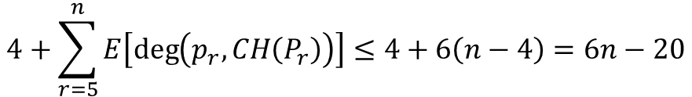
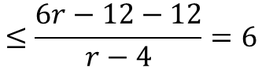
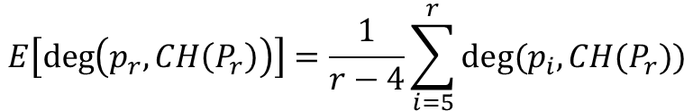
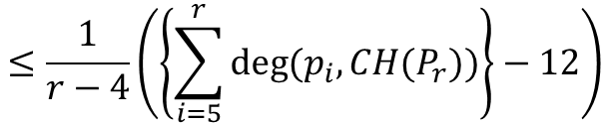
Convex Hull 3D - Analysis
$$E\left[\deg\left(p_{r}, CH\left(P_{r}\right)\right)\right]=\frac{1}{r−4}\sum_{i=5}^{r}{deg⁡(p_{i},CH(P_{r}))}$$
$$≤\frac{1}{r−4}\left(\left\{\sum_{i=5}^{r}{deg⁡(p_{i},CH(P_{r}))}\right\}−12\right)$$
$$≤\frac{6r−12−12}{r−4}=6$$
(bound) total amount of structural change
$$4+\sum_{r=5}^{n}{E\left[\deg\left(p_{r}, CH\left(P_{r}\right)\right)\right]}≤4+6\left(n−4\right)=6n−20$$
Notes:
1. First 4 points are fixed! pr is a random element of {p5,… pr}
2. p1, … p4 have total degree at least 12
3.
4. expec. Num of facets => 4 entry facets + total num. of facets created during the addition of p5,… pn

Slide 32
Convex Hull 3D - Analysis
The convex hull of a set of n points in R³ can be computed in O(n log n) randomized expected time.
Notes:
Proof:
Steps before main loop (can be done in O(n log n))
Stage r ➔constant if Fconflict(pr) is empty (lies inside or on the boundary of the CH)
→ Else: most: O(card(Fconflict(pr))) => cardinality(de:Mächtigkeit) of a set
=> card(Fconflict(pr)) => num facets deleted due to the addition of the point pr
=> facets deleted < facets created
=> exp. Num of facets created => O(n)
total num. Deletions is O(n)
E[sum(n, r=5){card(Fconflict(pr))}]=O(n)
=>
except line 17-19 and line 20
line 20 => lin. Number of nodes and arcs that are deleted (at most once) from G
line 17-19 => for all horizon edges (in L)
One Edge => O(card(P(e)))
total => O(sum(e from L) card(P(e))) => O(n log n)
(Over all Horizon Edges)

Slide 33
Sample Program
Implementation of a 3D convex hull program
→ 2D & 3D convex hull
→ parameter arguments as runtime-arguments (-h → help shows all possible arguments)
→ using OpenGL for the visualization
https://github.com/jonassorgenfrei/convexHull3D

Slide 34
Sample Program
main
(argument handling, creating random sets & running algorithm)
convexHull
(calculation of the convex hull in 2D and 3D Space)
visualization
(OpenGL implementation for visualizing points and topology)
DCEL
(Data structure for storing points & connectivity as planar graph)
point
(Interface, implemented by Point2D and Point3D)
conflictGraph
(Data structure for storing Conflicts between Faces & Points)
DCELVertex
DCELFace
DCEL HalfEdge
math
(linear algebra Calculations)
GLM (math library specialized for OpenGL)
GLAD (OpenGL Loading Library)
GLFW (API for multi-platform window creation, context, IO..)

Slide 35
Convex Hull 3D - Conclusion
running time (expected) O(n log n)
generalizes to higher dimensions (optimal in the worst case)
best deterministic convex hull algorithm for odd-dimensional spaces is based on a (quite complicated) de-randomization of this algorithm
improvements for applications
parallelize algorithm → use on Hardware (GPU)
Notes:
running time: worst could be O(n³)
proof: Computational Geometry, Algorithms and Applications (Book)
→ For dim. Higher than 3, the complexity of the CH is no longer linear in the number of points

Slide 36
Alternative Algorithms
Gift wrapping–algorithm
O(n²) worst case
Divide-and-conquer
O(n log n)
TODO: IMAGE!
TODO: IMAGE!
Notes:
Gift Wrapping Algorithm : rotating a plane over known edges untile the first point is found. Running time O(n f) f->facets
1. known algorithm for n-dimensions (1970)
Divide & Conquer: sort points in x-coord ; recursively split, construct CH, merge
Merge takes O(n) => O(n log n ) total times ➔ rely on circular ordering
Merge uses giftwrapiing

Slide 37
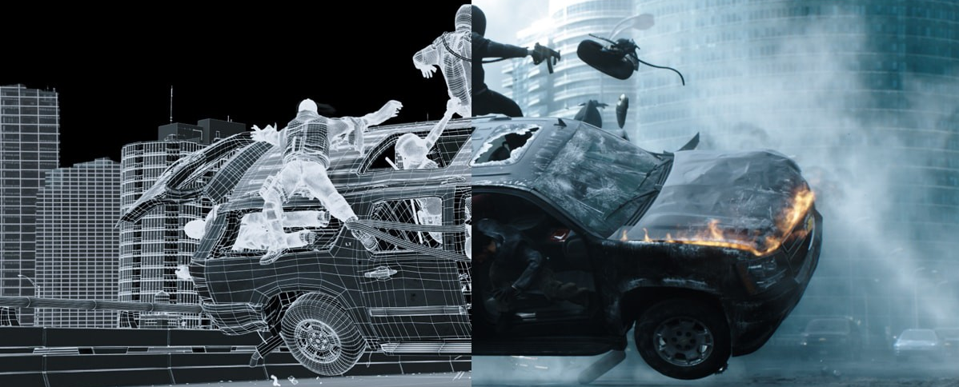
Computer Graphic Applications
Convex Hull 3D
Notes:
Creating images of modeled scenes for display on a computer screen
Scenes consist of geometric objects

Slide 38
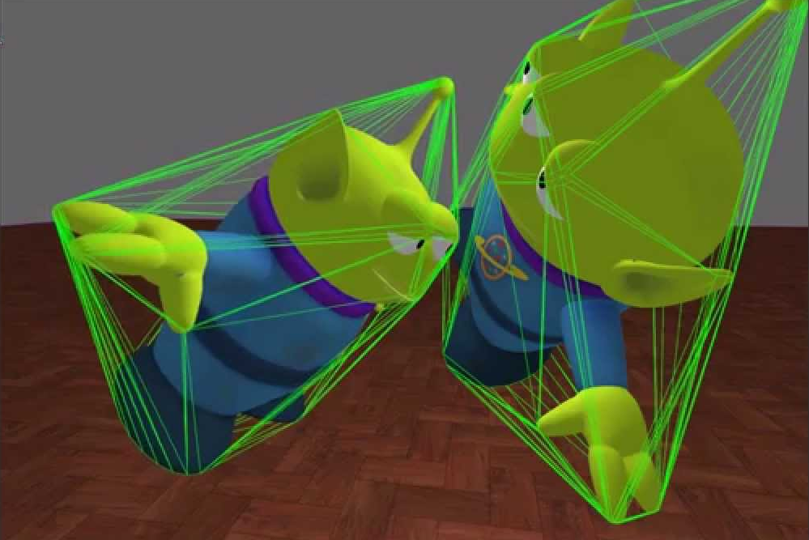
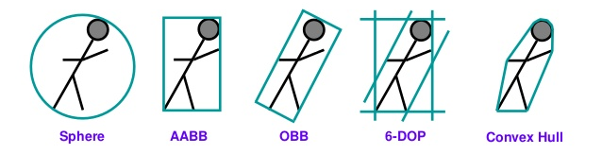
Computer Graphic Applications
Collision Detection in Computer Animation / Computer Games
speed up (when result is negative most of the time)
less costly then actual polyhedron
better approximation
Bounding Volumes
better bound
[1]
[2]
faster tests
Notes:
Detecting intersection of two or more objects
First Check if P1‘ and P2‘ intersect then check P1 and P2 (more costly)
Convex Hulls can approximate most objects a lot better
As well used in robotics applications

Slide 39


Computer Graphic Applications
Simulations in Movies as Special Effects & CGI (in Houdini)
3D animation software
especially for simulations & procedural generation
contains lot of computational geometry implementations
Bullet Solver
physic engine for 3D collision detection for simulations
computer games & visual effects in movies
https://www.sidefx.com/community/h17-launch/

Slide 40
Computer Graphic Applications
Renderering

Slide 41
Computer Graphic Applications
Batch Culling

Slide 42

Computer Graphic Applications
annual conference for computer graphics
papers using computational geometry algorithms & convex hull algorithms
https://www.siggraph.org/
http://kesen.realtimerendering.com/

Slide 43
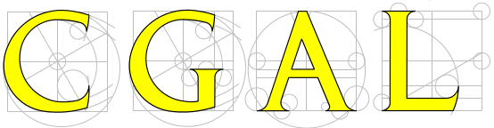
Computational Geometry – for Developers
Various Algorithms for Computational Geometry
C++ Library
Licensing: GPL3+ & commercial license
Demo Programs
https://www.cgal.org/
https://github.com/CGAL/cgal

Slide 44
Conclusion
ZUSAMMENFASSUNG GESAMMT

Slide 45
References
Mark de Berg / Otfried Cheong / Marc van Kreveld / Mark Overmars: Computational Geometry, Algorithms and Applications Springer 2008 (3. Aufl.), ISBN 978-3-540-77973-5
Convex Hull in 3D Dimensions – Peter Felkel Fel CTU Prague – Version 23.10.2014
GPU accelerated Convex Hull Computation - Min Tanga, Jie-yi Zhaoa, Ruo-feng Tonga, Dinesh Manochab
http://www.cs.ucr.edu/~eldawy/18SCS133/
https://www.sidefx.com/community/h17-launch/
http://www.cs.sfu.ca/~binay/813.2011/DCEL.pdf

Slide 46
Additional Ref
D. R. Chand and S. S. Kapur. An algorithm for convex polytopes. J. ACM,17:78–86, 1970.
B. Chazelle. An optimal convex hull algorithm in any fixed dimension. Discrete Comput. Geom., 10:377–409, 1993
K. L. Clarkson and P.W. Shor. Applications of random sampling in computational geometry, II. Discrete Comput. Geom., 4:387–421, 1989
M. Kallay. The complexity of incremental convex hull algorithms in Rd. Inform. Process. Lett., 19:197, 1984
C. O’ ’Du’nlaing and C. K. Yap. A “retraction” method for planning the motion of a disk. J. Algorithms, 6:104–111, 1985
F. P. Preparata and S. J. Hong. Convex hulls of finite sets of points in two and three dimensions. Commun. ACM, 20:87–93, 1977.
F. P. Preparata and M. I. Shamos. Computational Geometry: An Introduction. Springer-Verlag, 1985
R. Seidel. Output-Size Sensitive Algorithms for Constructive Problems in Computational Geometry. Ph.D. thesis, Dept. Comput. Sci., Cornell Univ., Ithaca, NY, 1986. Technical Report TR 86-784

Slide 47
External Graphics
Slide 3
[1] https://www.techiexpert.com/future-proof-clients-portfolios-robotics-ai/
[2] https://gisgeography.com/what-gis-geographic-information-systems/
[3] http://www.imperial.ac.uk/continuing-professional-development/short-courses/eng/electrical/cmos/
[4] https://ocw.mit.edu/courses/mechanical-engineering/2-158j-computational-geometry-spring-2003/
[5] https://www.cbronline.com/what-is/what-is-a-database-4917209/
[6] https://techterms.com/definition/rendering
[7] http://www.zbrushcentral.com/printthread.php?t=168180&pp=15&page=16
Slide 13
http://diskhkme.blogspot.com/2015/10/convex-hull-algorithm-in-unity-2-3d.html
Slide 14
https://upload.wikimedia.org/wikipedia/commons/0/02/Icosidodecahedron.png
Slide 17
https://commons.wikimedia.org/wiki/File:Truncated_cuboctahedron,_ball-and-stick,_triangles.png

Slide 48
External Graphics
Slide 33
http://www.cgrecord.net/2016/02/deadpool-vfx-breakdown.html
Slide 35
[1] https://www.youtube.com/watch?v=O4FC5rxEqGk
[2] https://www.slideshare.net/oiotoxt/collision-detection-ooxv0p2
Slide 36
https://www.sidefx.com/company/press/

